Slide 1
Dynamic HTML

Slide 2
Dynamic HTML
XHTML
content
CSS
style rules
appearance
manipulate
manipulate
Scripting
Language

Slide 3
DHTML
A combination of technologies used to create animated documents
Not a W3C standard!
  Originally, a marketing term used by Netscape and Microsoft
Using scripts, we manipulate HTML content and style properties in reaction to events

Slide 4
HTML DOM

Slide 5
HTML DOM
From W3C:
“A platform- and language-neutral interface that allows programs and scripts to dynamically access and update the content and structure of HTML and XHTML documents.”

Slide 6
DOM and JavaScript
Combined with JavaScript, every element in the HTML document is represented by an object
Elements can be manipulated using the properties and methods of the corresponding objects
Changes in the element properties are immediately reflected by the browser

Slide 7
Accessing HTML Elements
All HTML elements (objects) are accessed through the document object
document itself is automatically created
Several ways to access a specific element
  paths in the DOM tree
  retrieval by tag
  retrieval by ID

Slide 8
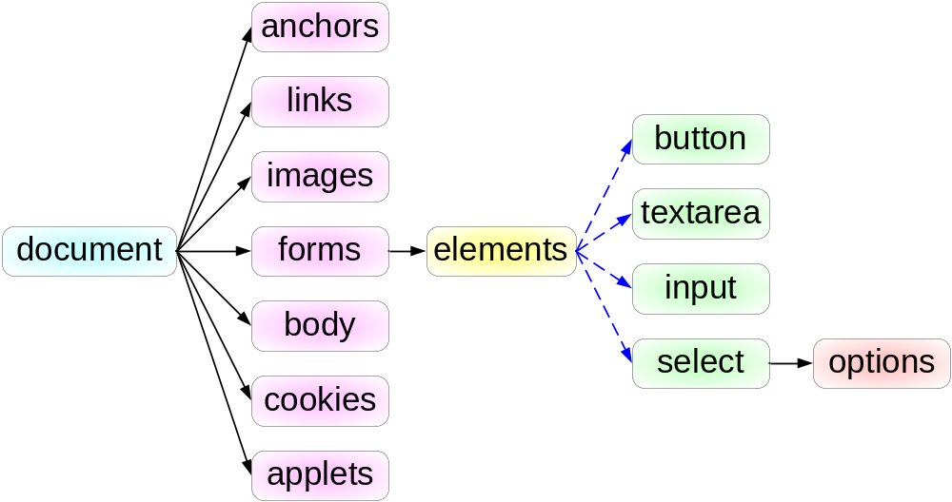
HTML DOM Tree

Slide 9
Accessing Elements by Paths
function execute() {
var img = document.images[0]; img.src="lighton.gif"
var inx = document.forms[0].elements[0]; inx.value="xx"
var iny = document.forms["form1"].elements["y"]; iny.value="yy"
}
head
<p><img src="lightoff.gif" alt="light off" id="img1" /></p>
<form id="form1" method="get" action="nosuch"><p>
<input type="text" name="x"/>
<input type="text" name="y"/>
<input type="reset"/></p>
</form>
body

Slide 10
Accessing Elements by Tags
function execute() {
var spans = document.getElementsByTagName("span");
spans[0].style.color="red";
spans[1].style.color="blue";
spans[1].style.fontVariant="small-caps";
}
head
<p>This <span>example</span> is lovely.</p>
<p>But <span>this one</span>is even more!</p>
body

Slide 11
Accessing Elements by ID
function execute() {
var theDiv = document.getElementById("div1");
if (theDiv.style.visibility=="hidden")
{theDiv.style.visibility="visible" }
else {theDiv.style.visibility="hidden" }
}
head
<div id="div1"> This text can be hidden!</div>
body
This technique is more stable w.r.t. document changes (why?)

Slide 12
Element Properties
Elements of different types have different sets of properties and methods
See www.w3schools.com/htmldom/ for a detailed list of element properties and methods
Most elements have the style member
style is an object that represents the style-sheet rules applied over the element

Slide 13
Events

Slide 14
Event Example
<html>
<head>
<title>Simple Events</title>
<script type="text/javascript">
function focusInput() {
var theInput = document.getElementsByTagName("input")[0]
theInput.style.background="yellow" }
function blurInput() {
theInput = document.getElementsByTagName("input")[0]
theInput.style.background="white" }
</script>
</head>

Slide 15
Event Example (cont)
<body>
<p>
<img src="lighton.gif" alt="light bulb"
onmouseover="alert('Mouse Over')" />
</p>
<p>
<input type="text" onfocus="focusInput()"
onblur="blurInput()" />
</p>
</body>
</html>

Slide 16
Event Model
Events usually occur due to users actions
  For example, pressing the keyboard, changing a text field, moving the mouse over an element, etc.
An event is represented by an event object that is created upon the event occurrence
Every event has an associated target element
  For example, the image over which the mouse clicks

Slide 17
Event Model (cont)
Elements can have registered event listeners which are associated with certain types of events
When an event takes place, the listeners that are registered for this event are invoked
Typically, a listener is described by a scripting code (e.g., JavaScript)
  This code is executed upon listener invocation

Slide 18
Inline Listener Registration
The simplest (and most common) way to register a listener is by an attribute assignment:
  ontype = "JavaScript code"
For example:
  <img src="img.gif" onmouseover="alert('!')" />
The JavaScript code has access to the following objects:
  this - the element (e.g., the image defined above)
  event - the event object

Slide 19
Some Event Types
load
unload
abort
click
dblclick
mousedown
mousemove
mouseup
mouseover
reset
select
submit
keydown
keypress
keyup
change
blur
focus

Slide 20
Another Example
<html>
<head><title>Event Object Example</title>
<script type="text/javascript">
function execute(e) {
alert(" x: " + e.clientX + ", y: " + e.clientY +
" mouse button: " + e.button); }
</script></head>
<body onmousedown="execute(event)"
style="cursor: pointer;
position:absolute; width:100%; height:100%"> </body>
</html>

Slide 21
Form Validation
In the form element, onsubmit="code" defines a listener with a special functionality
When the form is supposed to be submitted, code is executed before submission
The code can return a Boolean value
  e.g., onsubmit="return function()"
If code returns false, submission is cancelled!

Slide 22
Form Validation - Simple Example
<html>
<head><title>Form Validation</title>
<script type="text/javascript">
function validate() {
var theX = document.forms[0].x.value;
var theY = document.forms[0].y.value;
if(theX != theY) { alert("x != y!!"); return false; }
else { return true; }
}
</script>
</head>

Slide 23
Form Validation - Simple Example (cont)
<body>
<form id="email-form" action="myurl" method="get"
onsubmit="return validate()">
<p>
x: <input type="text" name="x" />
y: <input type="text" name="y" />
<input type="submit" />
</p>
</form>
</body>
</html>

Slide 24
Form Validation - Another Example
<head><title>Form Validation</title>
<script type="text/javascript">
function validateEmail(form) {
var emailRegExp = /^\w+\@\w+\.\w+$/;
var theEmail = form.email.value;
if(theEmail.match(emailRegExp)) { return true; }
alert(theEmail + " is not a valid email!");
return false;
}
</script>
</head>

Slide 25
Form Validation - Another Example (cont)
<body>
<form id="email-form" action="myurl" method="get"
onsubmit="return validateEmail()">
<p>
Name: <input type="text" name="Name:" /> <br/>
Email: <input type="text" name="email" />
<input type="submit" />
</p>
</form>
</body>

Slide 26
Form Submission
A form can be submitted without the special submission button
Use the function form.submit() to submit a specific form from JavaScript code

Slide 27

Mouse-Click Events
To register a listener for the click event, use can use the onclick attribute of the element
  Apply the style rule cursor:pointer to the element in order to get the pointer effect
Alternatively, you can link to a JavaScript code:
  <a href="javascript:code">Click here</a>

Slide 28
Event Flow
<script type="text/javascript">
function f1() { alert("1") }
function f2() { alert("2") }
function f3() { alert("3") }
</script>
<body>
<div onclick="f1()">
<p onclick="f2()">
<img src="lighton.gif" alt="light" onclick="f3()"/>
</p>
</div>
</body>

Slide 29
Event Flow (cont)
When we click on the image, which of the functions should be executed?
  Answer: all of them!
In what order?
Two different models:
  Microsoft (impl. in IE)
  W3C (impl. in Mozilla, Opera 7, Konqueror)

Slide 30
Microsoft Model
Event Bubbling: events propagate through the elements in bottom-up order
  i.e., from the most specific to the most general
Whenever an element is visited, its listeners are triggered
In our example: img → p → div

Slide 31
W3C Model
In the W3C model, there are 2 traversals:
  Event capturing: top-down
    e.g., div → p → img
  Event bubbling: bottom-up
    e.g., img →p → div
Element 1
Element 2

Slide 32
Event Flow (cont)
A listener can be registered in either the capturing or the bubbling phase
By default, listeners register in the bubbling phase
  So, what will be the result of the example code?
An element may choose to stop the flow at any listener execution, by calling event.stopPropagation()
  In IE: event.cancelBubble = true

Slide 33
An Example
What will happen if we replace f2 with the following?
function f2(e) {
alert("2");
if(e.stopPropagation) e.stopPropagation();
if(e.cancelBubble!= undefined) e.cancelBubble=true;
}

Slide 34
Dynamic Listener Registration
A listener can be dynamically registered by using JavaScript code
Microsoft:
  element.ontype = functionName
element.attachEvent("ontype", functionName)
Note that the function is given as an object
The function is called without arguments
The event can be accessed using window.event

Slide 35
Dynamic Listener Registration (cont)
W3C:
  element.ontype = functionName
element.addEventListener("type", functionName, isCapture)
The function is called with event as an argument
If isCapture is true, the listener is registered for the capturing phase

Slide 36
Manipulating the Document Structure

Slide 37
Structure Manipulation
In structure manipulation, we
  add/remove/replace HTML elements
  change the text under elements
Two approaches:
  DOM tree manipulation (W3C specification)
  Setting the innerHTML attribute (not a specification)

Slide 38
DOM Tree Manipulation
In this approach, we explicitly
  create new nodes
  add created nodes to the DOM tree
  remove old nodes
To create new nodes, use these methods of document:
  document.createElement("tag")
  document.createTextNode("text")
  document.createAttribute("attname")

Slide 39
DOM Tree Manipulation (cont)
To add and remove children of a specific element, use the following methods:
  element.appendChild(newChild)
  element.insertBefore(newChild, child)
  element.removeChild(child)
  element.replaceChild(newChild, oldChild)

Slide 40
An Example
<html>
<head><script type="text/javascript">...</script></head>
<body>
<p>First Paragraph.</p>
<div id="d1"><p id="p1">Second paragraph.</p></div>
<p>
<input type="button" value="replace" onclick="replace(this)" />
</p>
</body>
</html>

Slide 41
An Example (cont)
function replace(button) {
d = document.getElementById("d1");
p = document.getElementById("p1");
h = document.createElement("h1");
text = document.createTextNode("This is a header.");
h.appendChild(text);
d.replaceChild(h,p);
button.disabled=true;
}

Slide 42
The innerHTML Property
The attribute innerHTML attribute of an element is the HTML code embedded inside that element
Hence, you can replace existing content by setting this attribute:
  element.innerHTML = "new HTML code"
Not recognized by W3C specifications, but supported by Web browsers

Slide 43
Previous Example with innerHTML
function replace(button) {
d = document.getElementById("d1");
d.innerHTML = "<h1>This is a header<\/h1>";
button.disabled=true;
}

Slide 44
The window Object

Slide 45
The window Object
Built-in object called window
Represents the browser window of the document
Several window objects may co-exist
  Separate windows/tabs
  Separate frames
Default object – need not specify window to access its properties and methods
  window.alert() and alert() are the same

Slide 46
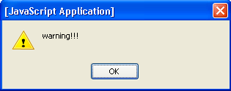
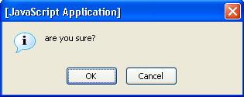
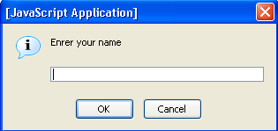
Dialog Boxses
alert("warning!!!");
confirm("are you sure?");
  returned value is Boolean
prompt("enter your name");
  returned value is either a string or a null object
Rendering stops until box closure!

Slide 47
An Example
<script type="text/javascript">
alert("You are about to start");
document.write("Started<br/>");
conf = confirm("Should I continue?");
if(conf) {
name = prompt("Enrer your name")
document.write("Your name is " + name +".<br/>");
}
</script>

Slide 48
The location Object
The object window.location represents the current URL of the window
For example:
  location.href - the current URL (can be changed!)
  location.hostname
  location.pathname
Also has methods:
  location.reload(),
  location.replace(‘URL’)

Slide 49
Opening New Windows
window.open("URL") - opens URL in a new window
  you can specify other properties, like size, whether it is resizable, etc.
  returns the new window object

Slide 50
Accessing Window Frames
window.top - the topmost window
window.frames - a collection of the frames in the window
For example, in a specific frame, use window.top.frames[i] to get to another frame

Slide 51
The navigator Object
The object window.navigator contains information about the browser
For example:
  navigator.appName - the name of the browser
  navigator.appVersion - the version of the browser
  navigator.cookieEnabled
  navigator.platform - the OS name

Slide 52
The history Object
The object window.history enables navigation according to the navigation history
For example:
  history.back() - same as clicking the back button
  history.forward() - same as clicking the forward button
  history.go(i) - go forward i times
    If i is negative, go back -i times

